Slide 1


Credit card default analysis
CREDIT CARD
DEFAULT ANALYSIS
Presented by: Balusu Chaitanya Prudvi | Aadesh Patil | Vaishnavi Kanetkar | Shingala Harsh

Slide 2
Introduction
The need for digital payments is growing as people shift more and more toward online and card-based payment methods.
Credit card default is a major problem brought on by such a shift. The number of credit cards issued, and the overwhelming amount of debt owed by cardholders has quickly expanded as more and more customers rely on credit cards to pay for their routine purchases in brick-and-mortar stores and online.
Therefore, the problems of credit card fraud and default must be addressed by all economic institutions. According to financial figures provided by the Federal Reserve, the default rate on credit card loans across all commercial banks is at an all-time high.
The main goal of this project is to find patterns among various factors such as age, gender, married status and education with credit card default.
Determining Z and P values using mcnemar’s test.

Slide 3
Steps followed
Introduction
Data Exploration
Mcnemar’s Test
Results
Conclusion

Slide 4
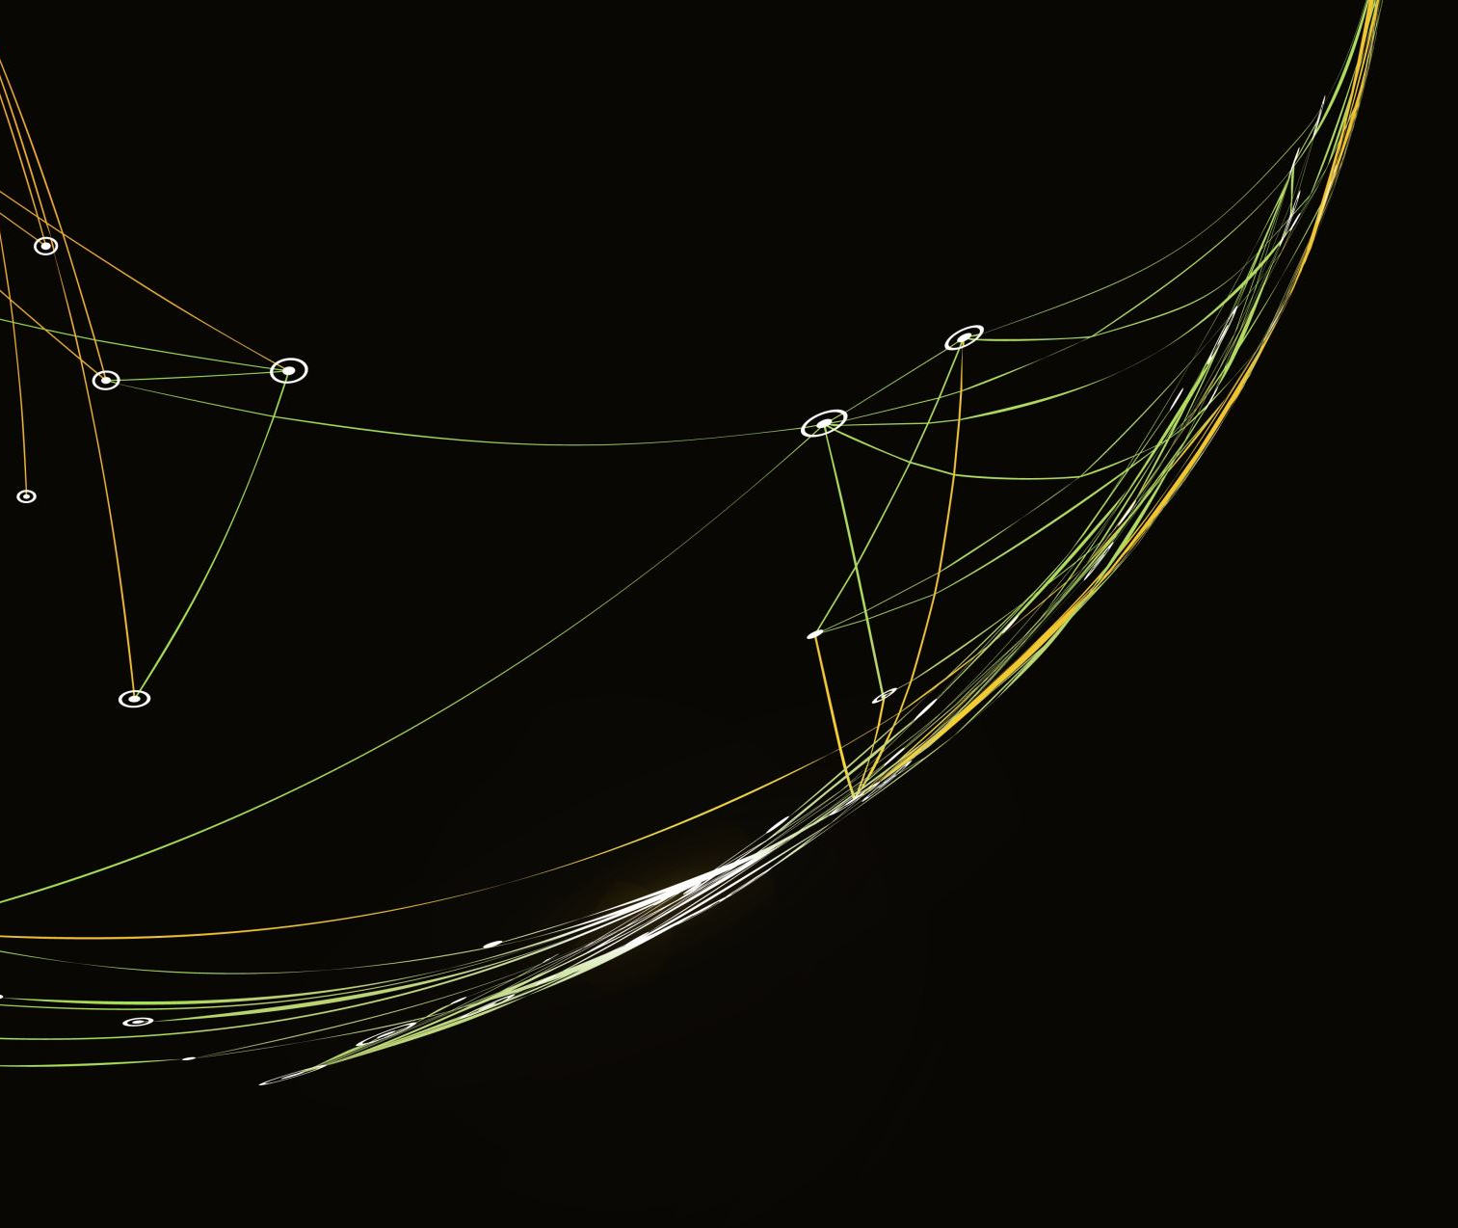
Classical Approach Vs Robust Approach

Slide 5
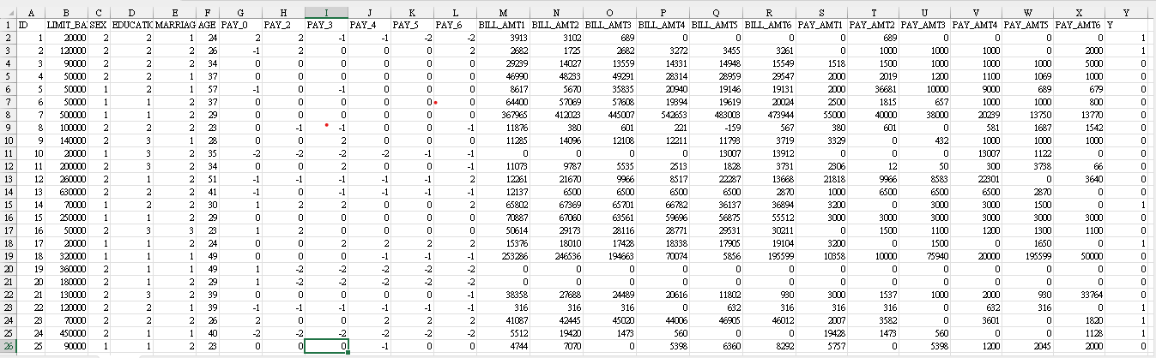
Data

Slide 6
Data description
There is a total of 23 diverse features and 1 target variable. The description of features is given below:
LIMIT_BAL: Amount of the given credit (NT dollar): it includes both the individual consumer credit and his/her family (supplementary) credit.
SEX: Gender (1 = male; 2 = female).
EDUCATION: Education (1 = graduate school; 2 = university; 3 = high school; 4 = others).
MARRIAGE: Marital status (1 = married; 2 = single; 3 = others).
AGE: Age (year).
PAY_0 - PAY_6: History of past payments.
The past monthly payment records (from April to September 2005)
The measurement scale for the repayment status is:
-1 = pay duly
1 = payment delay for one month
2 = payment delay for two months
8 = payment delay for eight months
9 = payment delay for nine months and above.
BILL_AMT1 - BILL_AMT6: Amount of bill statement (NT dollar).
PAY_AMT1 - PAY_AMT6: Amount of previous payment (NT dollar).

Slide 7
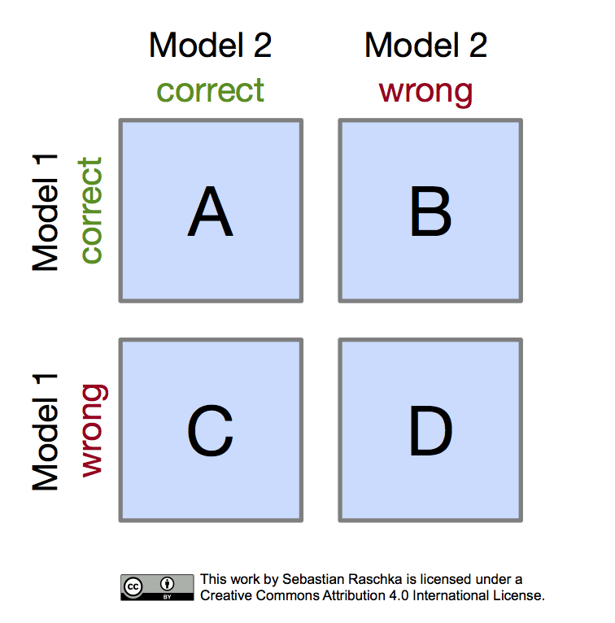
The Robust Mcnemar’s Test
Robust Mcnemar's Test is used to pair binomial data.
Robust Mcnemar’s test is used in diagnostic test in medical sciences to find if a patient is suffering from the disease or not suffering from the disease.

Slide 8

Hypothesis II
Null Hypothesis (H0): There is no significant relationship between marital status and the likelihood of defaulting on credit card payments.
Alternative Hypothesis (H1): A significant relationship exists between marital status and the likelihood of defaulting on credit card payments.

Slide 9
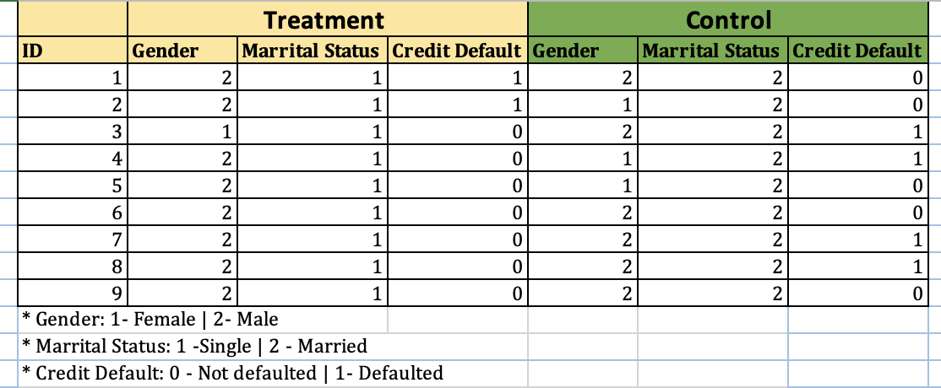
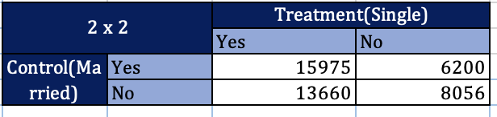
Contingency table for Marital status vs credit card default
Concordant pairs
(CONTROL=TREATMENT=0 or CONTROL=TREATMENT=1),
Significantly high
Accept null hypothesis
Or else
Reject null hypothesis

Slide 10
RESULTS
P values are < 0.01
Reject Null Hypothesis
A significant relationship exists between marital status and the likelihood of defaulting on credit card payments.

Slide 11

Hypothesis III
Null Hypothesis (H0): There is no significant relationship between age and the likelihood of defaulting on credit card payments.
Alternative Hypothesis (H1): There is a significant relationship between age and the likelihood of defaulting on credit card payments.

Slide 12
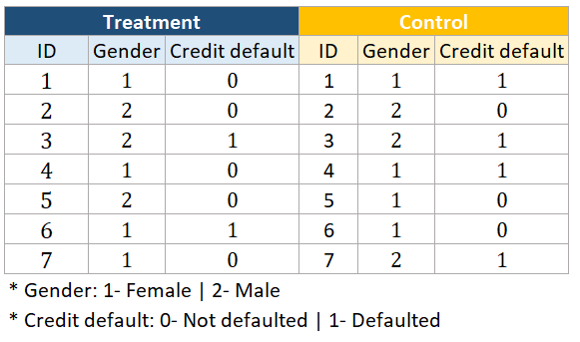
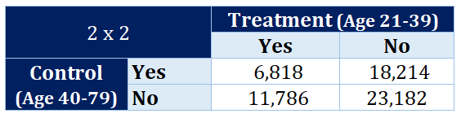
Contingency table for Age vs Credit default
Concordant pairs
(CONTROL=TREATMENT=0 or CONTROL=TREATMENT=1),
Significantly high
Accept null hypothesis
Or else
Reject null hypothesis

Slide 13
RESULTS
P values are < 0.01
Reject Null Hypothesis
There is a significant relationship between age and the likelihood of defaulting on credit card payments.

Slide 14
Robust Mcnemar’s Test
This test is apt for our hypothesis for following reasons:
● The data we are using is discrete
● We can easily distinguish between different groups
● 2X2 Contingency table give straight-forward end results
● Suitable for pair-wise analysis

Slide 15

Thank you

